Slide 1


Making small data big:
The Biodiversity Data Journal (BDJ)
19th International Congress of Arachnology (ICA 2013)
Kenting National Park, Taiwan; June 23-28, 2013
Lyubomir D. Penev^{1,3}, Teodor A. Georgiev³, Pavel E. Stoev^{2,3}, David M. Roberts⁴ & Vincent S. Smith⁴
1 Institute for Biodiversity and Ecosystem Research, Bulgaria
2 National Natural History Museum, Bulgaria
3 Pensoft Publishers
4 The Natural History Museum, UK
pensoft.net/journals/bdj
ViBRANT

Slide 2
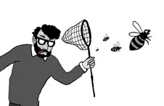
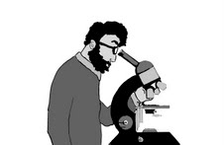

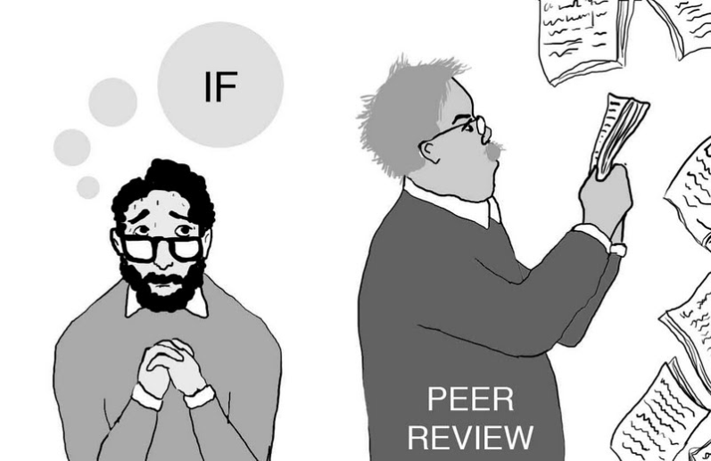
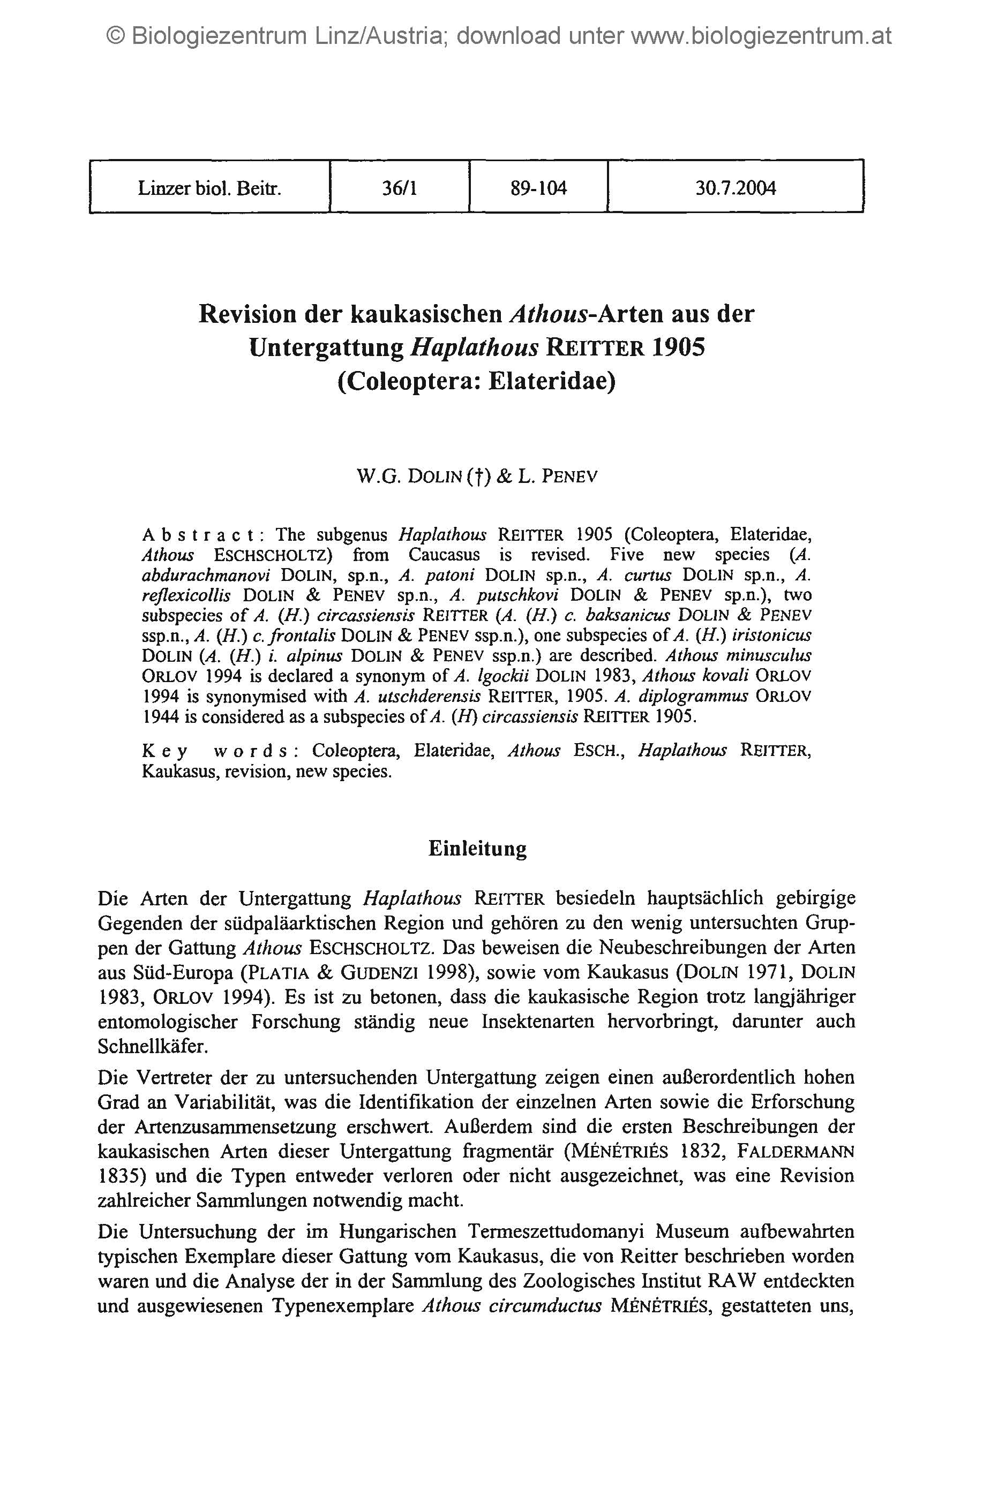




Drawings: slavenapeneva.com
Primary data

Slide 3
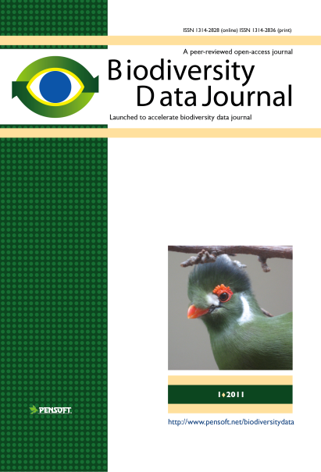
RE-USE
of
CONTENT
Publishing and sharing of primary data
Primary data

Slide 4
Incentives for authors and institutions to publish data
open data increases transparency and the overall quality of science
published data can be verified by other researchers
it can be integrated with other datasets
it increases the potential for interdisciplinary research
duplication of data-collecting efforts and associated costs will be reduced
published data can be indexed and made discoverable
27
Notes:
4
There are several incentives for authors and institutions to publish data:
There is a widespread conviction that data produced using public funds should be regarded as a common good, and should be openly published and made available for inspection, interpretation and re-use by third parties.
Open data increases transparency and the overall quality of science; published datasets can be re-analyzed and verified by others;
Published data can be cited and re-used in the future, either alone or in association with other data;
Open data can be integrated with other datasets across both space and time;

Slide 5
Notes:
5
Slide 12: Next generation article publishing
Arguably our most ambitious developments in the context of scholarly communication concern the semi-automated construction of scholarly papers from databases. In many cases Scratchpads contain extensive data relating to the biology and description of particular species. These are highly suited to formal specialist publications, but doing so require the laborious assembly of these data into a manuscript. As part of the ViBRANT collaboration with Pensoft, and in particular their two journals specialising in the formal taxonomic descriptions of plants and animals, we have developed a 5-step workflow for users to selecting appropriate data from their Scratchpad, adding additional metadata describing this information so that it conforms with the norms of descriptive taxonomic publications, and then finally preview and submit this manuscript to the publisher. From here is goes through a standard peer review process. Review recommendations are then incorporated in to a revised version of the manuscript, which is then sent back to the publisher and simultaneously published on both the Scratchpad and in the publisher’s journal.
In addition to dramatically speeding up the construction of scientific papers, the user has the advantage that firstly the manuscript can be revised and updated and new information comes to light on the Scratchpad, while preserving the original version of the manuscript as part of the scholarly record. In addition the publish extracts relevant information from the submitted database which is them automatically submitted to the specialist data repositories.
So in sum then, these are the four ways in which ViBRANT is facilitation scholarly communication of biodiversity information. 1) Through low cost journal infrastructure; 2) by community web publishing; 3) by biodiversity observation data publishing; and 4) by next generation publishing services producing scholarly articles from databases.

Slide 6
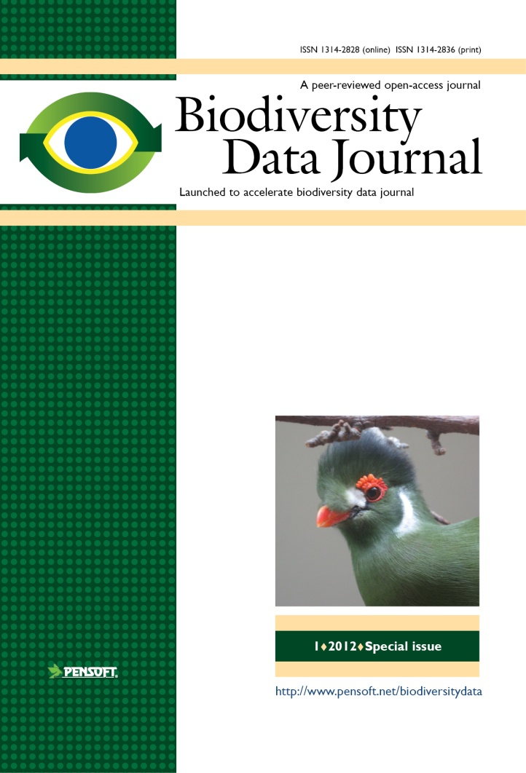

Key features
Biological Codes compliant article templates
No lower/upper limit of manuscript size
Semantically enhanced “articles of the future”
Integrated with GBIF, EOL, Dryad, Scratchpads, etc.
ALL DATA MATTERS!

Slide 7
Manuscripts are automatically formatted during the writing process
Avoids layout stage, decreases costs and efforts!

Slide 8

Automated registration
Manuscript
SUBMISSION
Peer review
XML Query
MANUSCRIPT
ACCEPTED
XML Response
XML article metadata
ARTICLE
PUBLISHED
Taxon name available/valid
(effectively published)

Slide 9
Automated import of treatments from Scratchpads and author’s own databases

Slide 10
No installation!
Just register and go!

Slide 11
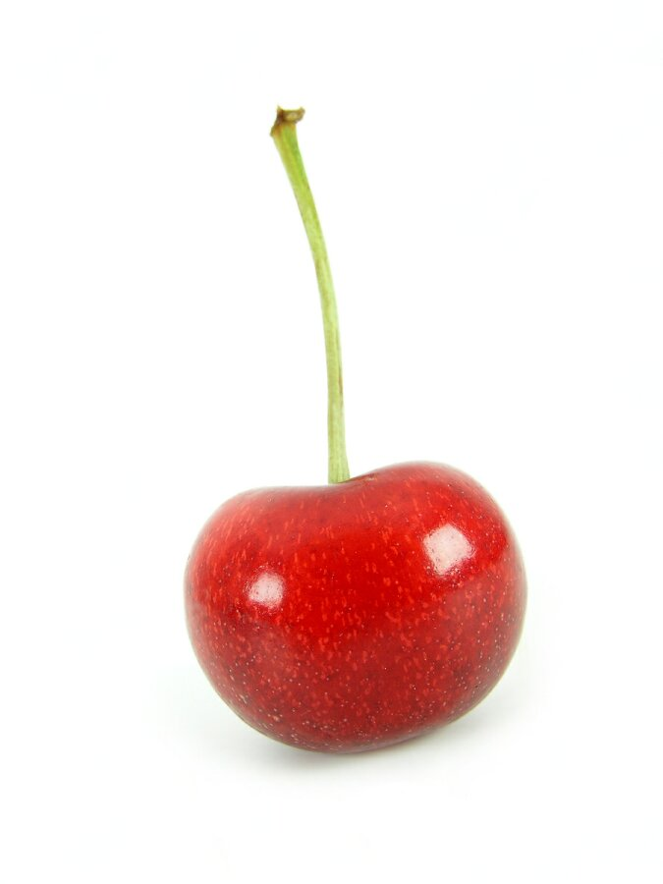

Slide 12
NO Author Guidelines!
The tool guides you!

Slide 13
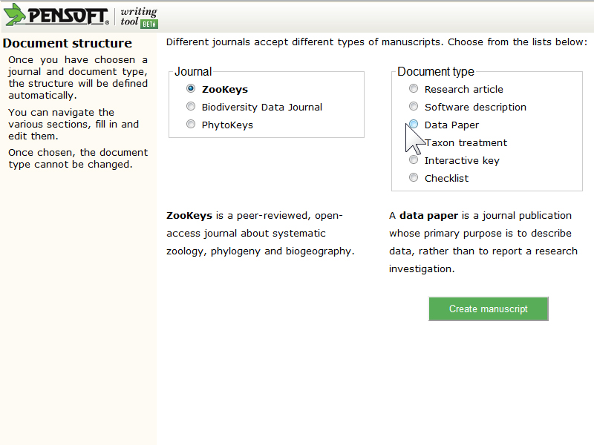
Choose article template

Slide 14
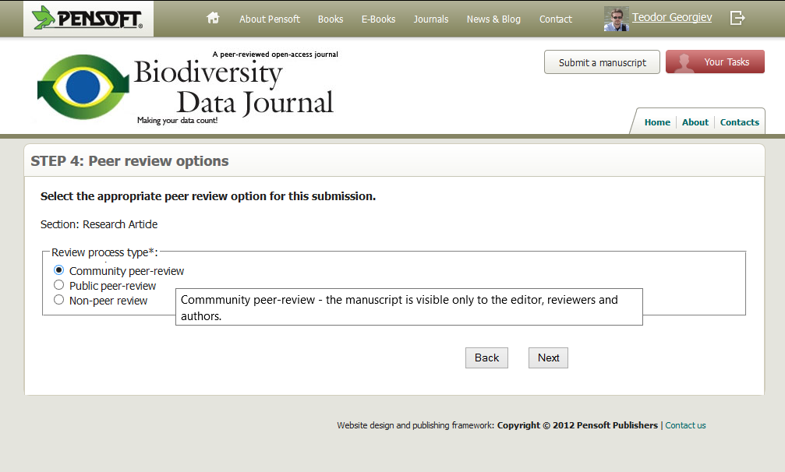
Authors can choose the review type
Notes:
The type of the article determines the possible choices.
For example an editorial can be either non-peer or peer-reviewed,
while a taxonomic paper can only be peer-reviewed.

Slide 15
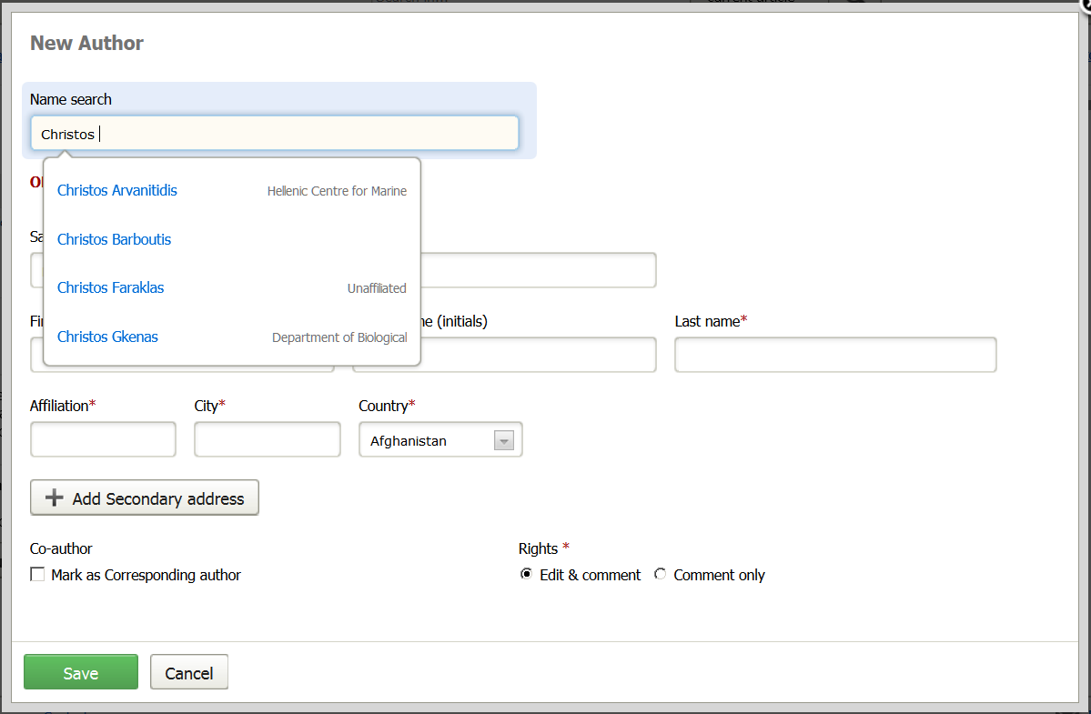
Add author

Slide 16
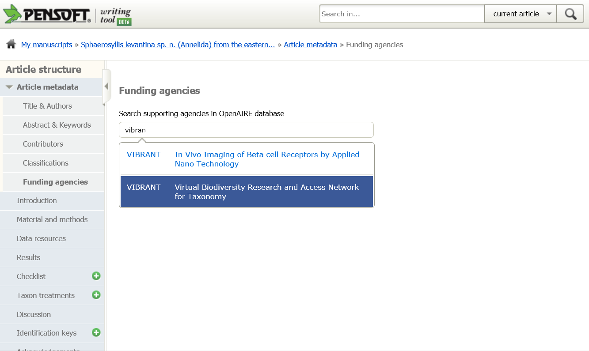

Slide 17
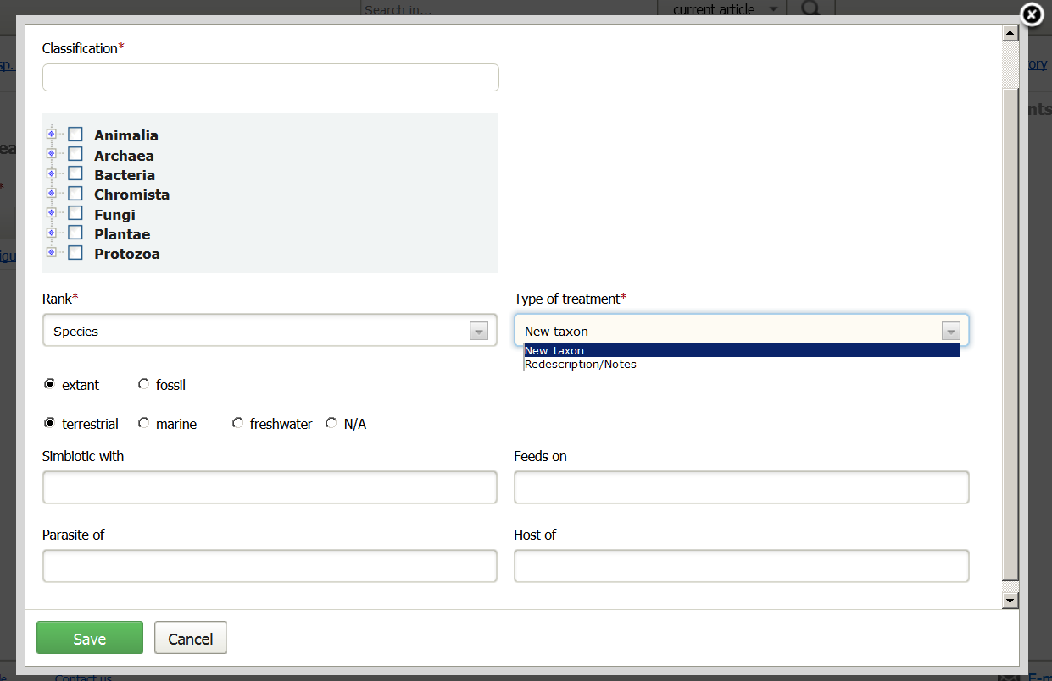

Slide 18
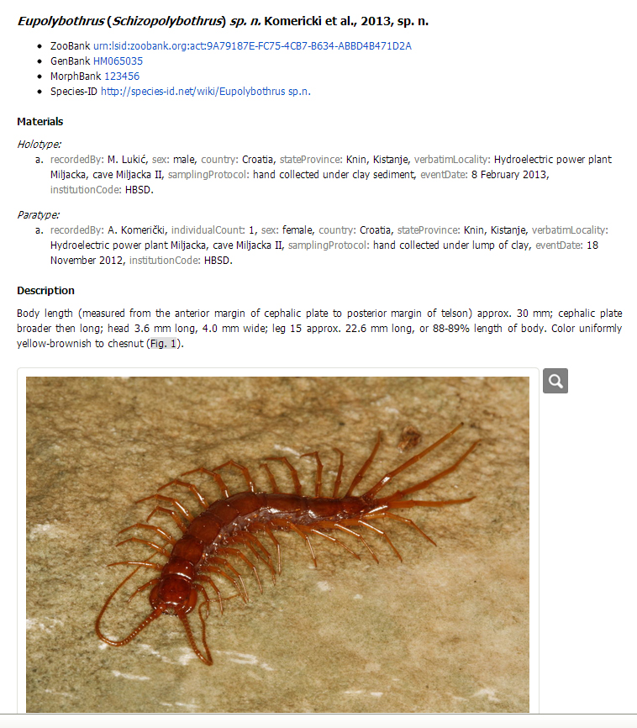
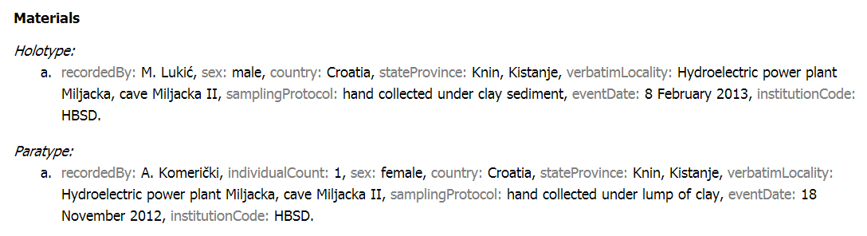
Taxon treatment: new species

Slide 19
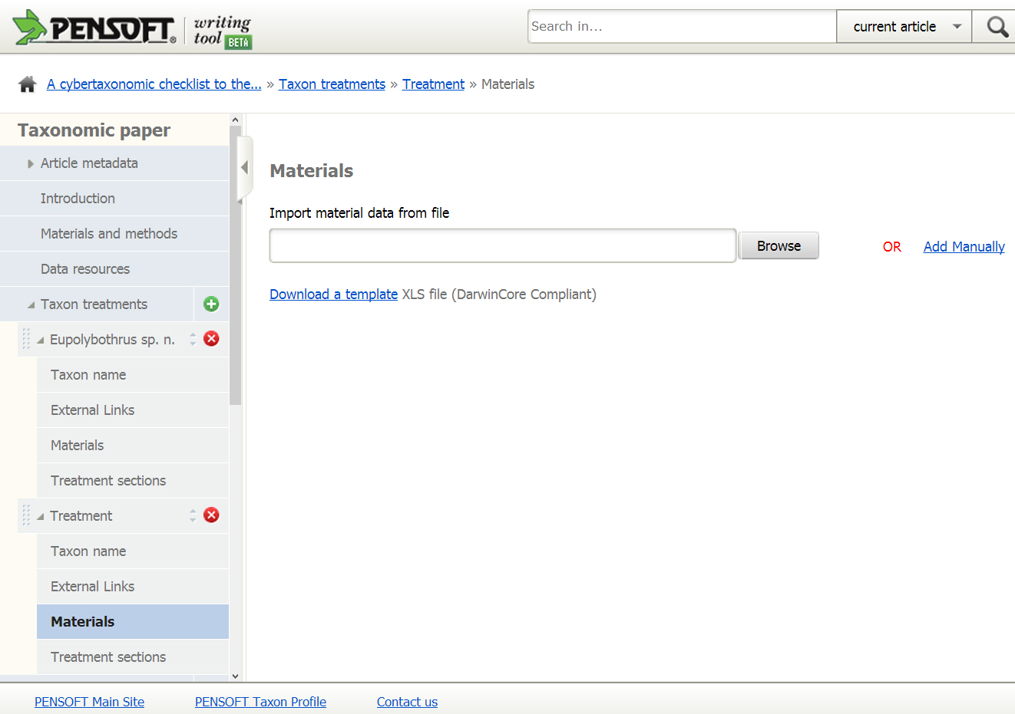
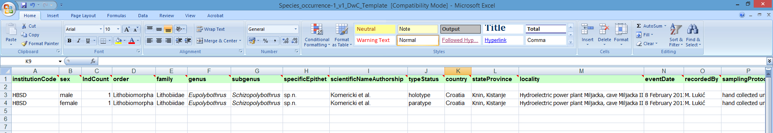
Taxon treatment: import material data

Slide 20
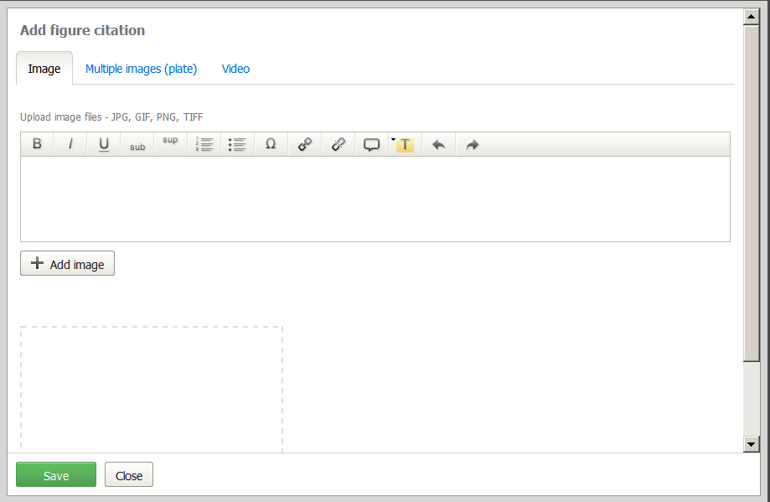
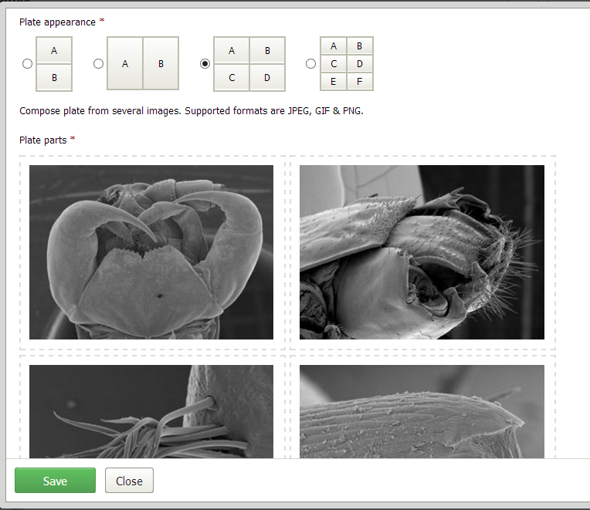
Taxon treatment: upload of images

Slide 21
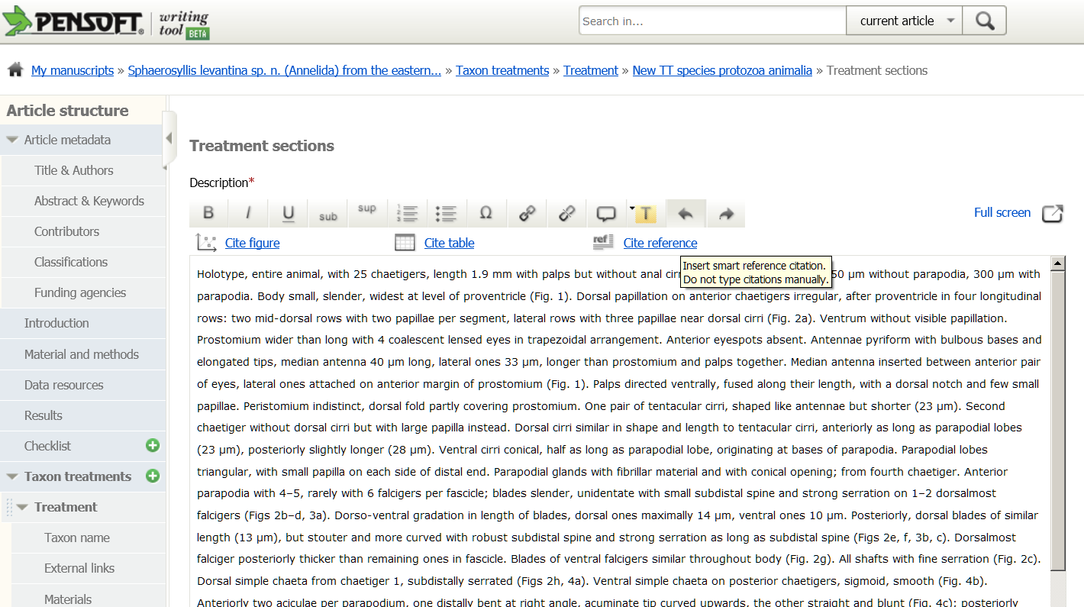

Slide 22
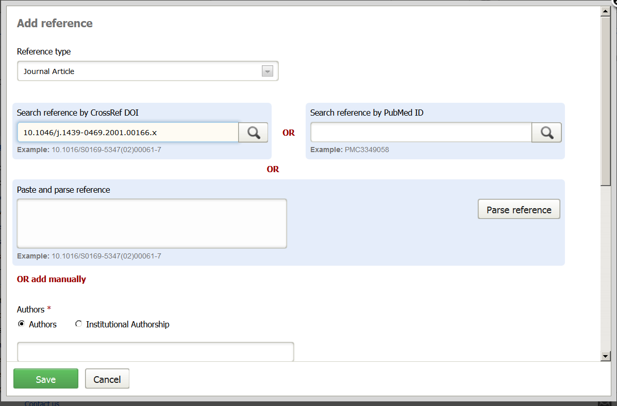

Slide 23
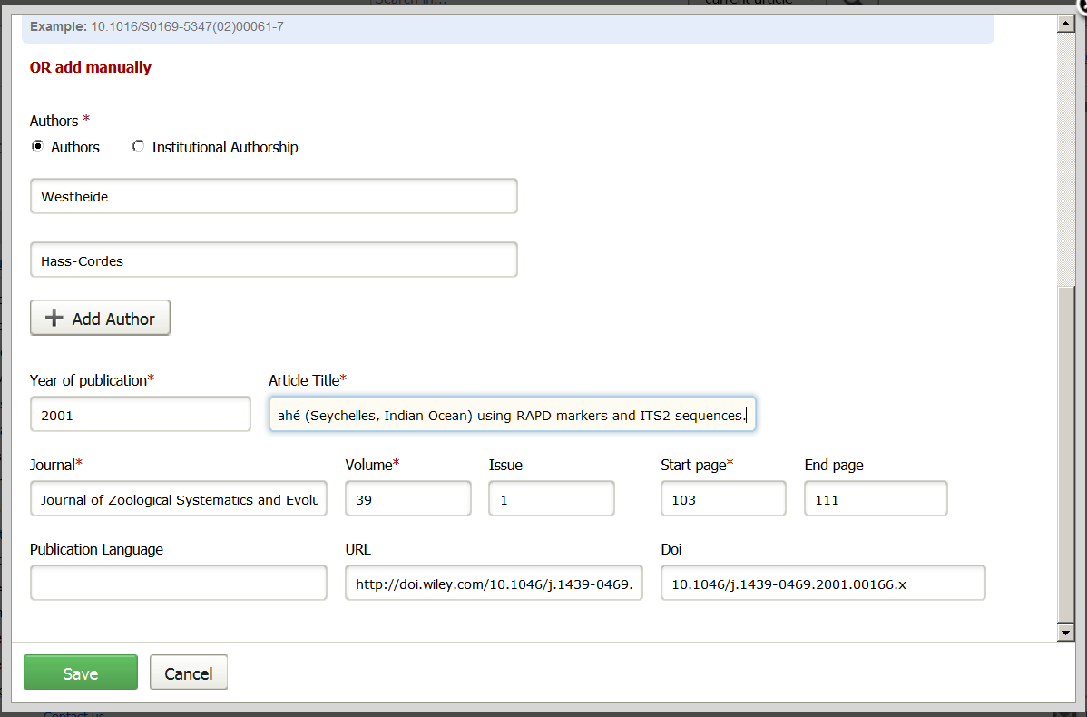

Slide 24
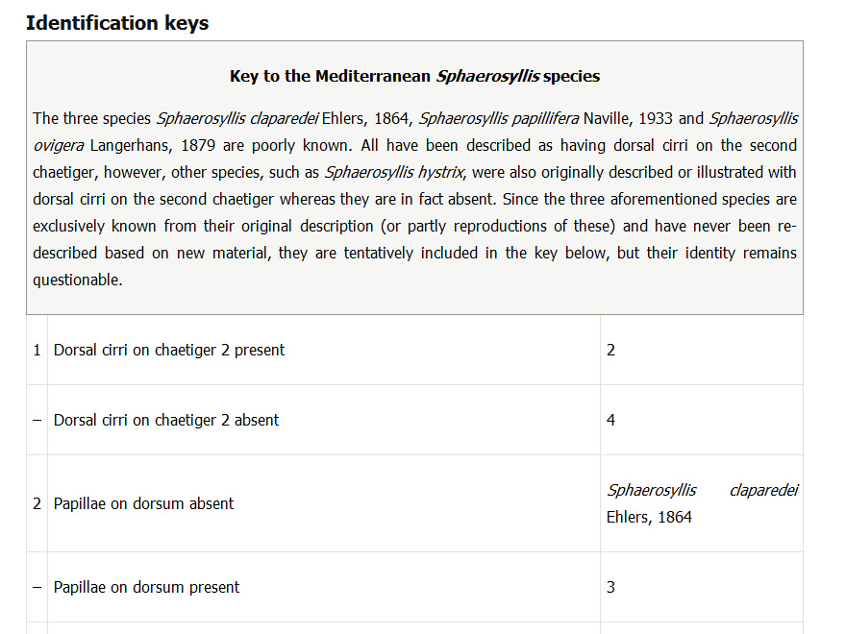
Key preview

Slide 25








Life cycle of data published in the BDJ
Occurrence data
Any other data
Genome dada
Morphometric data
Biodiversity
manuscript
Phylogenetic data
Image galleries
Environmental
data
XML
MARK UP
Structured text
(data!)
ARTICLES
Biblio-
graphies
Occurrence
data
Taxon treatments
Taxon names
Plazi
Wiki
COL
BHL

Slide 26

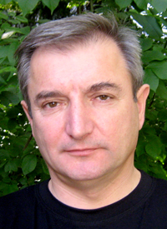



Thank you for listening!
19th International Congress of Arachnology (ICA 2013)
Kenting National Park, Taiwan; June 23-28, 2013
Lyubomir Penev
Dave Roberts
Teodor
Georgiev
Vince Smith
We Open Access!
ViBRANT

